Slide 1
USDA ERS Broadband
Midterm Status Update
Kat Savchyn, Sarah McDonald, Raghav Sawhney
June 28, 2019

Slide 2
Project Overview
Timeline & Status Overview
Literature Review
Data Inventory
Data Discovery Activities
Next Steps

Slide 3
Project Overview
Part of broader ERS effort to examine impact of infrastructure development on rural property values
The DSPG team is investigating the following research questions:
Can we validate FCC data on broadband availability and subscription rates?
Based on a literature review, what factors other than broadband predict property values?

Slide 4





Timeline and Status
Literature Review
Exploratory Data Analysis
Synthesize and Report Findings
Activity
Data Discovery & Acquisition
Heuristics Development
Artifact
Annotated bibliography
Reproducible code for data scraping
Informative visualizations for discovery
Metrics to inform data quality
Synthesized findings to inform future analysis

Slide 5
Literature Review
Based on a literature review, what factors other than broadband predict property values?
Walkability
Crime Rates
Proximity to Amenities (transportation, parks, sports facilities)
Environmental Attributes (noise, flood risk, water quality)
The DSPG team utilized a theme-driven conceptual framework to conduct research surrounding methods to address this question

Slide 6
Data Inventory
The DSPG team conducted an in-depth cross-reference comparison for the 3 major data sources, focusing on:
Data Collection Methods
Data Quality
Data Coverage
The outcomes of these activities will support development of heuristics and cross-referencing of resources surrounding Broadband data

Slide 7
Data Discovery: FCC Form 477
Fixed Broadband Deployment Data (as of December 2017)
Presence and Upload/Download speeds by Provider on block level
Provider-reported

Slide 8
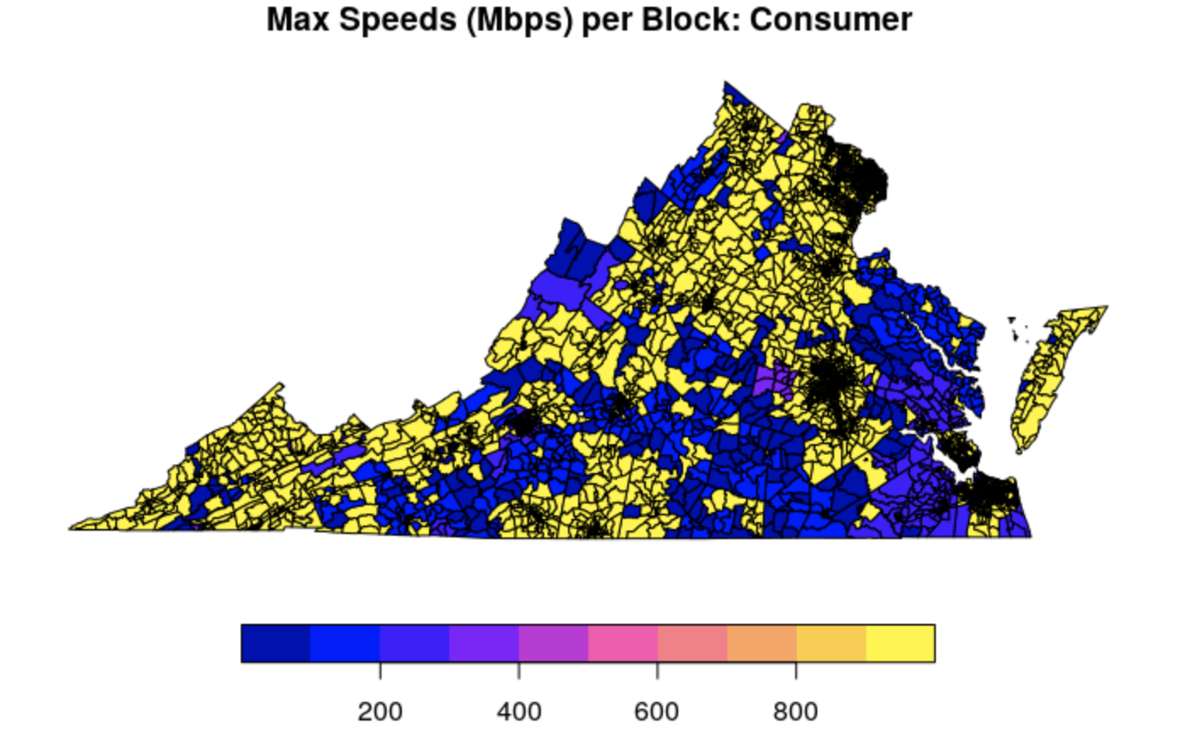
Data Discovery: FCC Form 477
Next Step:
may have to aggregate to ZCTAs level for comparison to broadbandnow.com

Slide 9
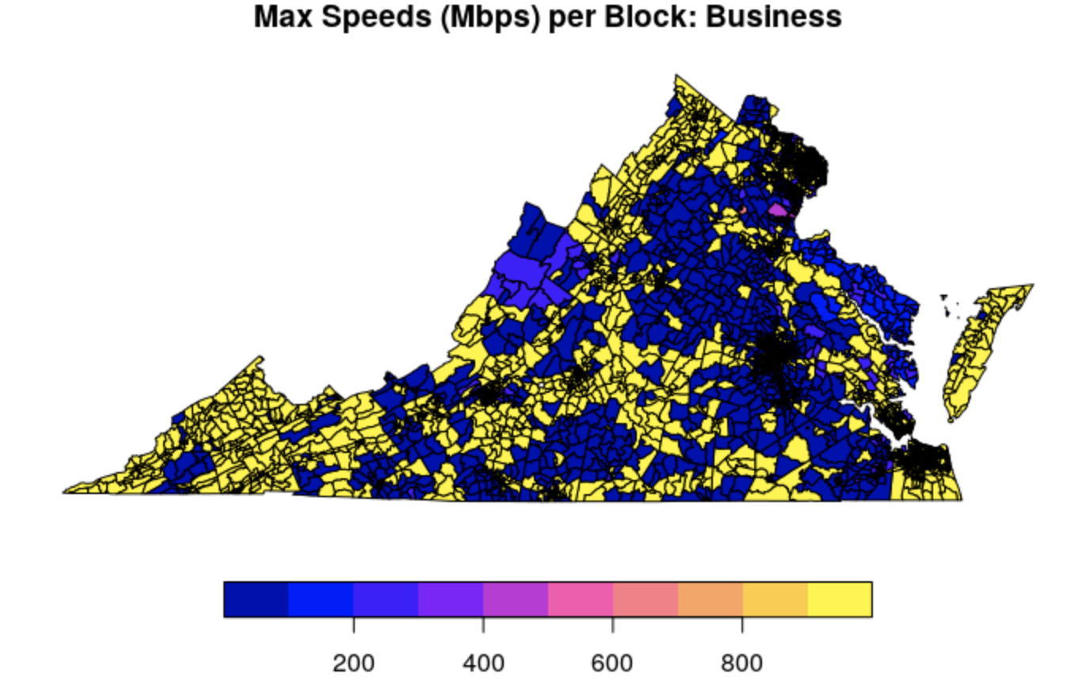
Data Discovery: FCC Form 477

Slide 10
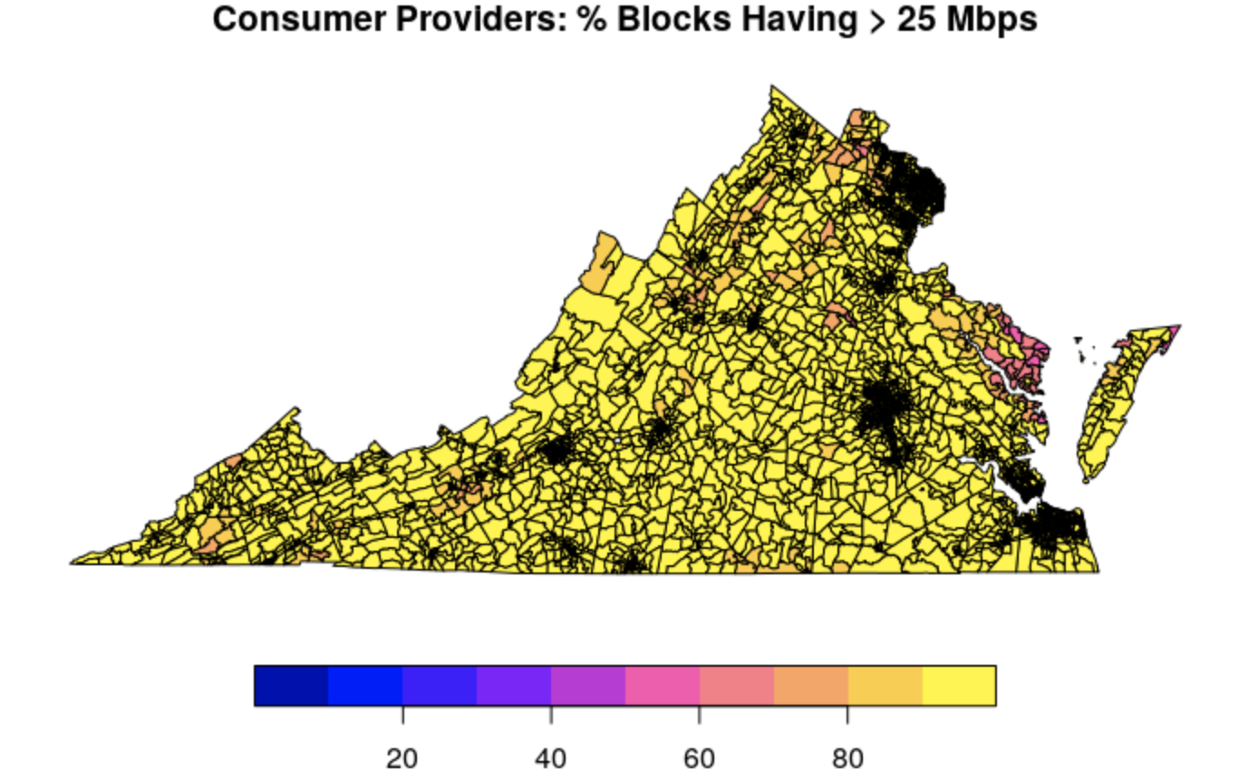
Data Discovery: FCC Form 477
Next Step:
add in Decennial Census data on population counts to determine % of population with access

Slide 11
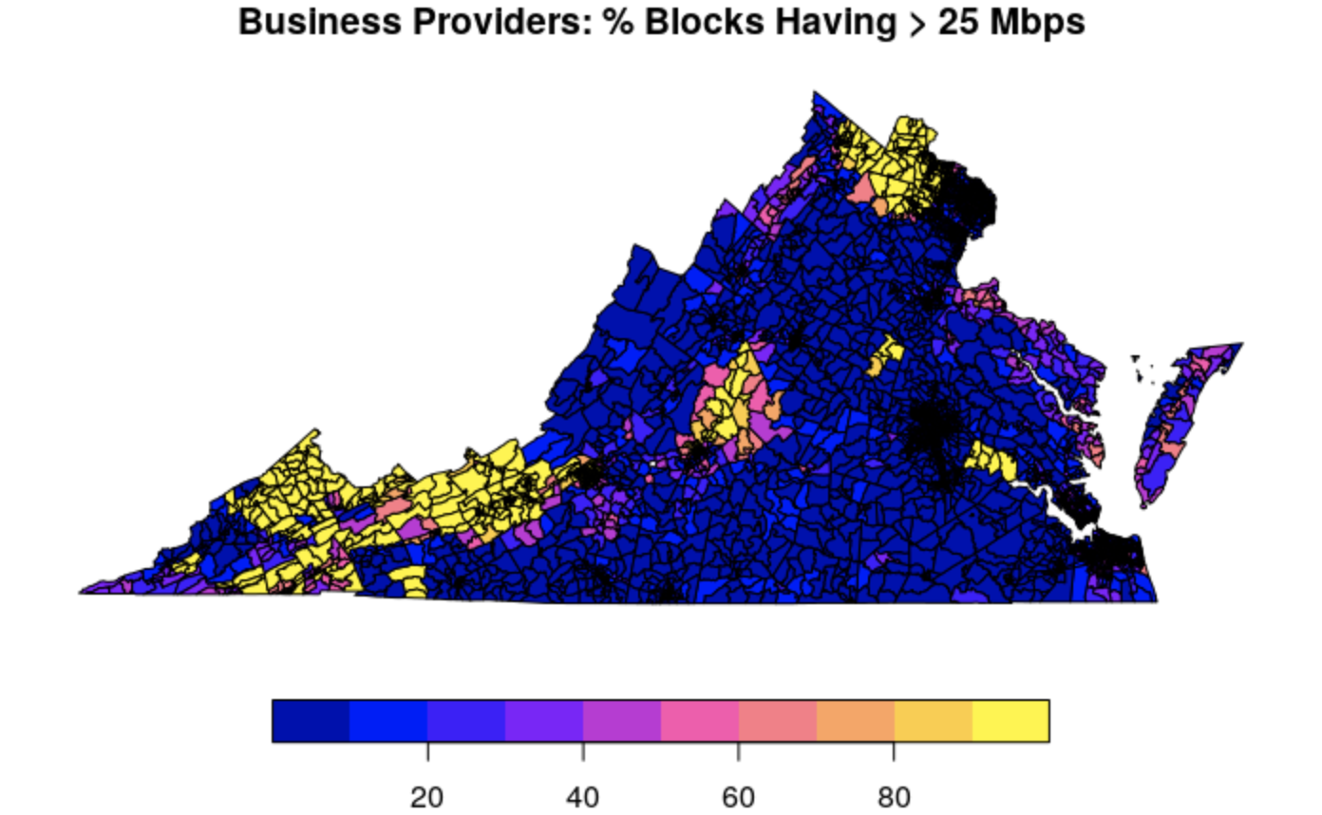
Data Discovery: FCC Form 477
Next Step:
add in Decennial Census data on population counts to determine % of population with access

Slide 12
Data Discovery: American Community Survey
2013-2017 Five-Year Summary
Presence and Types of Internet Subscription in Households
Presence of a Computer and Type of Internet Subscription by Household
Self-reported
Households

Slide 13
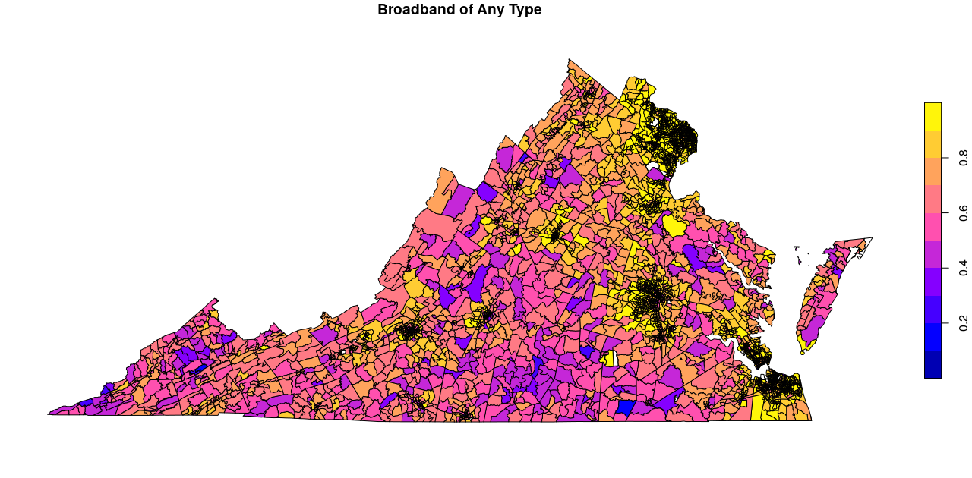
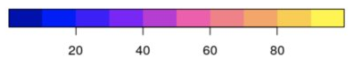
Data Discovery: American Community Survey

Slide 14
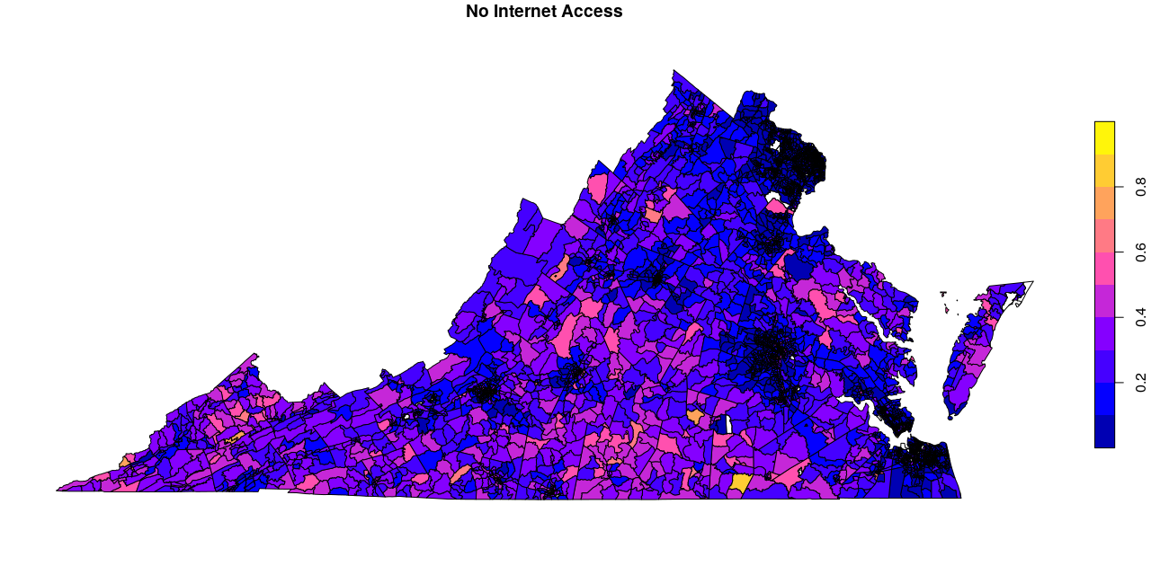
Data Discovery: American Community Survey

Slide 15
Ethics
Assumptions:
Broadband increases public wellbeing
Property value as a proxy for public wellbeing
Biases:
Data used has known misrepresentation issues
However, the goal of the study is to benchmark and validate the differing sources

Slide 16
Data Discovery: Next Steps
Finalize EDA exercise by reconciling and comparing the data across 3 major data sources
Incorporate rural-urban filter layers
Build quality metrics/heuristics to discuss data reliability

Slide 17
Q & A

